Slide 1

Is the possession of nuclear weapons linked to a country's economic health and overall stability?
By: Chanel Jones
Notes:
• Welcome everyone.
• Today, we explore if nuclear weapons impact a country’s economic health and stability.
• We’ll use economic and human development indicators for our analysis.
We will use some key terms, the first being:
• Human Development Index (HDI): Measures health, education, and living standards.
• Gross Domestic Product (GDP): Total market value of goods and services produced.
Simplified Version of the Hypothesis Question Do more nukes make a country more stable and richer?

Slide 2
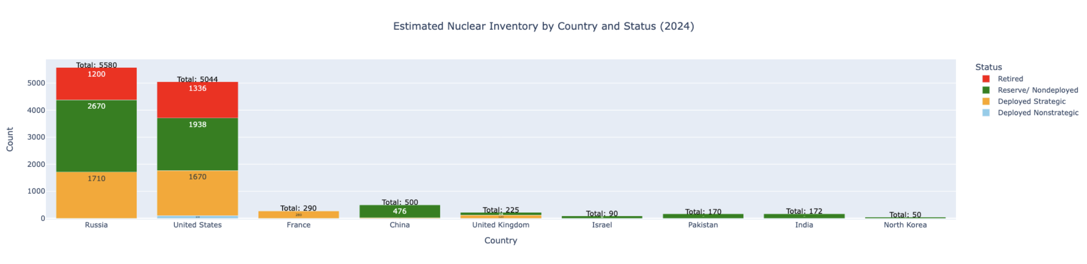
Notes:
This slide provides an overview of the estimated nuclear inventory of different countries. The graph highlights the number of nuclear warheads each country possesses as of the latest available data. Understanding the distribution of nuclear weapons is crucial for analyzing their potential impact on economic health and stability.

Slide 3
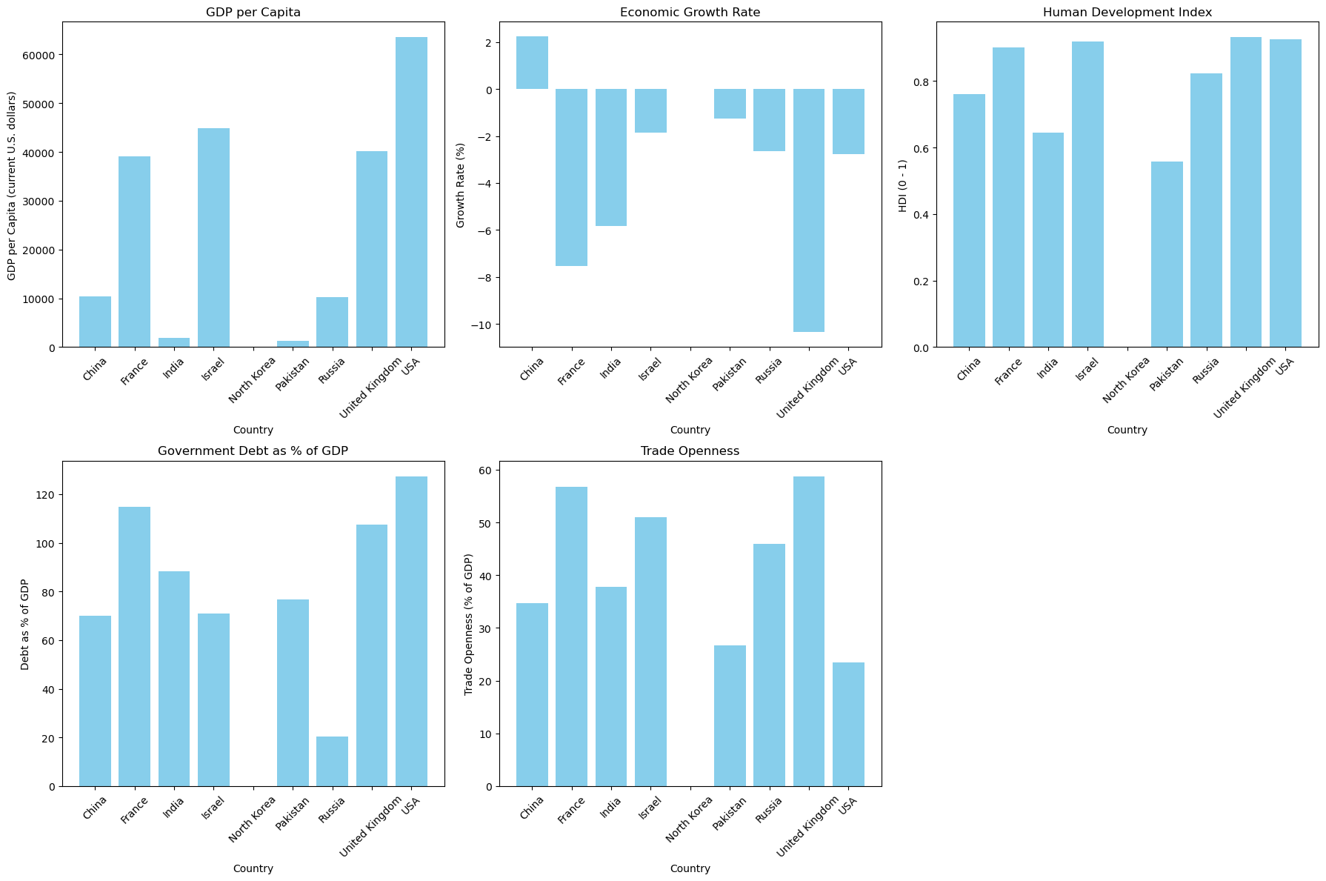
Notes:
The graphs compare economic indicators for countries with nuclear warheads in 2022.
1. GDP per Capita is Highest in the USA, UK, France, Israel; lower in China, Russia, India, Pakistan, North Korea.
2. Economic Growth Rate vary widely among the countries, with some experiencing positive growth and others negative, likely influenced by the global impact of the COVID-19 pandemic.
3. HDI Scores are High in the USA, UK, France, Israel; lower in others.
4. The UK and the USA have higher levels of government debt relative to their GDP, while other countries have varying, often lower, levels of debt.
5. Israel and the UK show higher trade openness, meaning a larger share of their GDP comes from trade. The other countries display varying levels of trade openness.

Slide 4
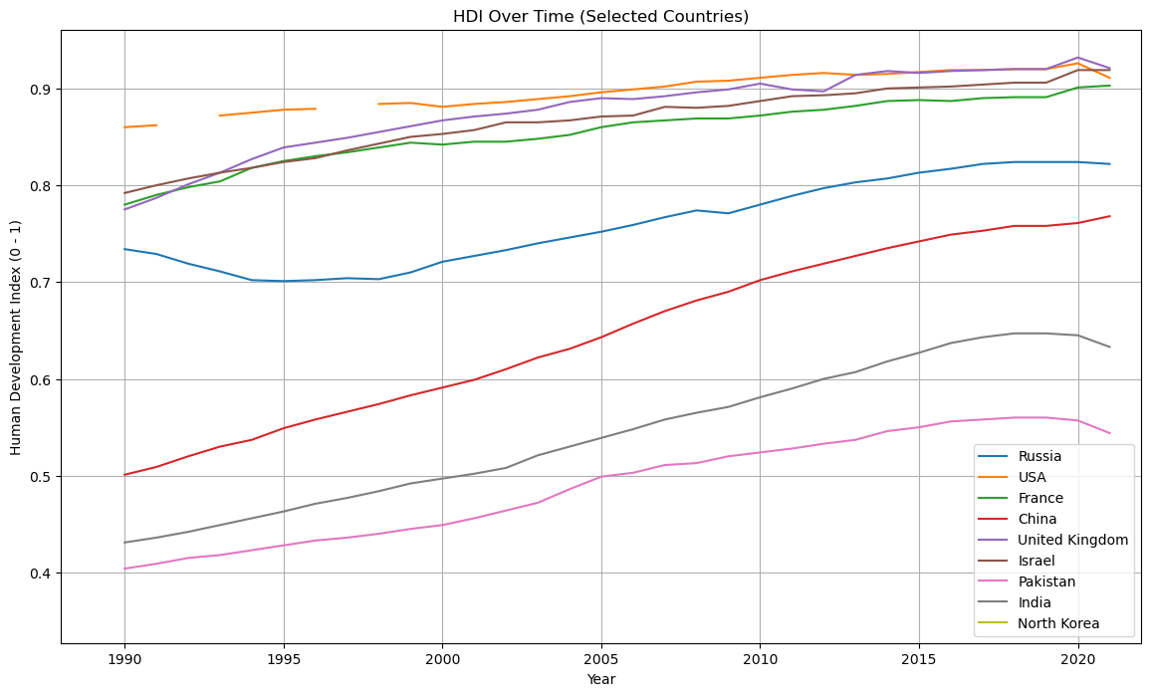
Notes:
The bar chart shows the HDI for the countries with nuclear warheads in 2022.
• USA, UK, France, Israel have high HDI values close to 1, reflecting very high levels of human development.
• China Has a high HDI, showing significant development and improved living standards.
• Russia Shows a relatively high HDI, indicating good human development.
• India and Pakistan Have moderate HDI values, indicating ongoing development but still room for improvement.
This comparison highlights the disparities and levels of human development among the countries.

Slide 5
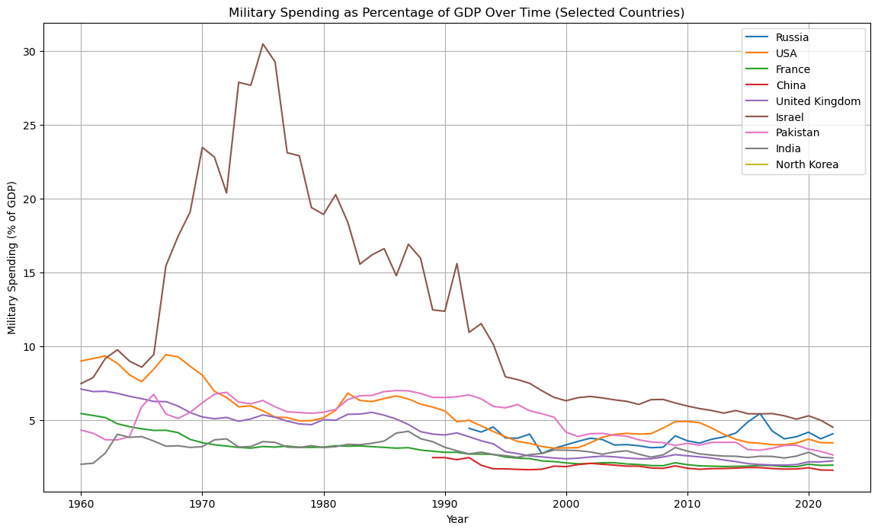
Notes:
This graph displays how military spending as a percentage of GDP has changed over time for countries with nuclear warheads.
Spikes or drops in military spending may correlate with historical events, such as conflicts, economic crises, or changes in government policy.
For example, the spike we see in the Israel in the 70s was due to the Cold War

Slide 6
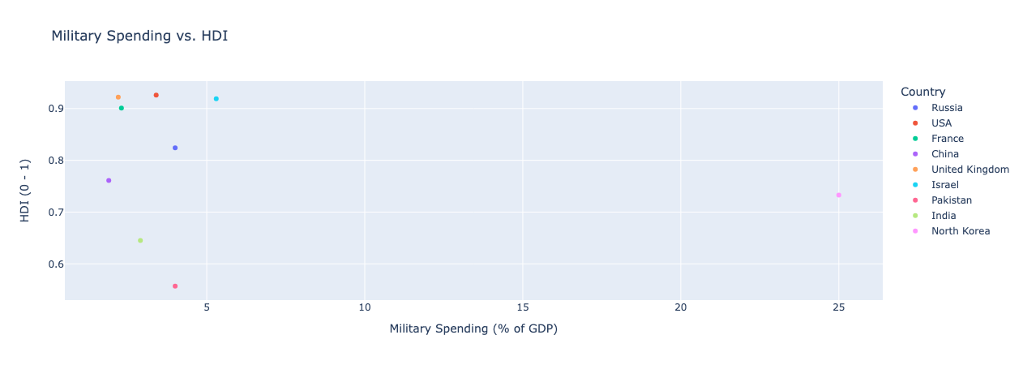
Notes:
The graph allows us to see if there’s a correlation between higher military spending and human development, indicating whether countries that allocate more of their GDP to military expenses tend to have higher or lower levels of human development. Outliers can highlight countries with high military spending but lower human development, or vice versa.

Slide 7
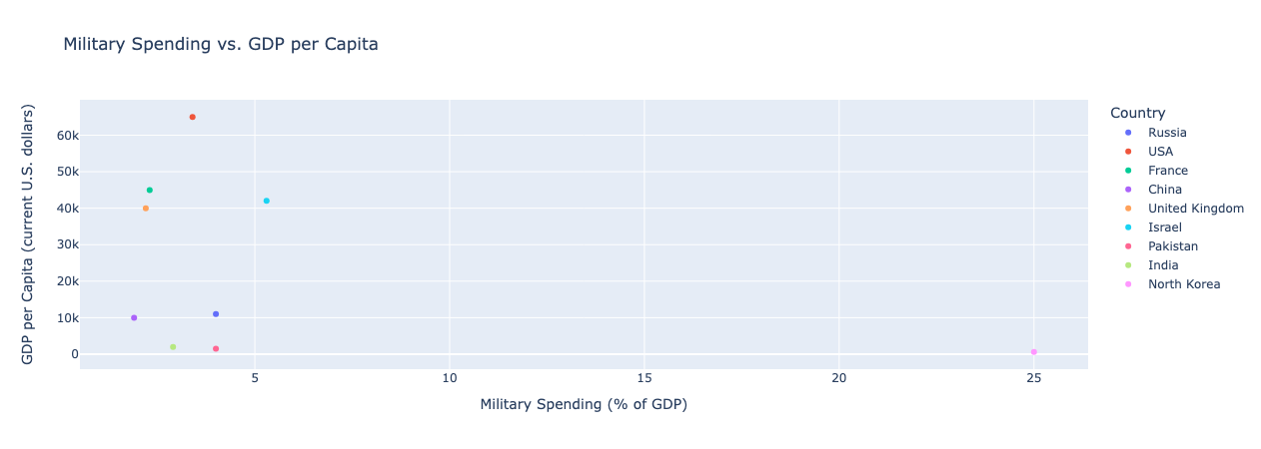
Notes:
The graph allows us to see if there’s a correlation between higher military spending and economic prosperity, revealing whether countries that spend more on their military tend to have higher or lower GDP per capita. Outliers in the plot indicate countries with unique economic and defense spending priorities.

Slide 8
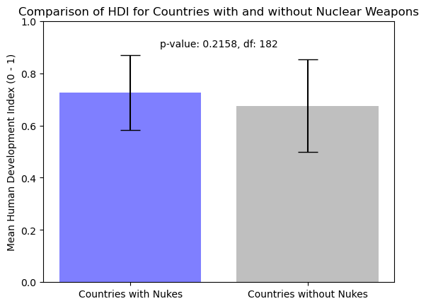
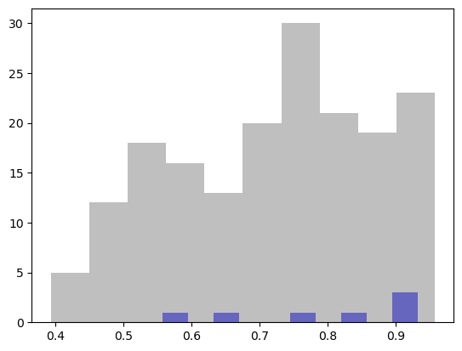
Notes:
The histogram shows a comparison of the HDI between countries with and without nuclear weapons. The analysis indicates that countries with nuclear weapons tend to have a slightly higher HDI on average. However, this difference is not statistically significant, as there is considerable overlap between the HDI values of the two groups. Specifically, the HDI values for both groups converge around 0.75, indicating that countries with and without nuclear weapons have similar HDI scores in this range. This overlap suggests that while there might be a slight tendency for nuclear-armed countries to have higher HDI values, it is not enough to conclude that nuclear status alone significantly impacts HDI.

Slide 9
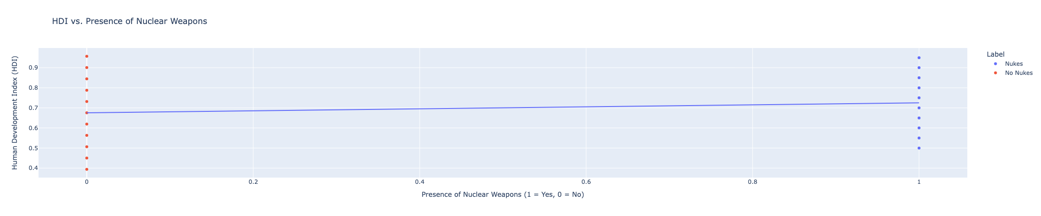
Notes:
This graph determines relationship between a country having nuclear weapons and its HDI. The blue dots represent actual HDI values for countries, with the x-axis showing whether a country has nuclear weapons (1 means it has nukes, 0 means it doesn’t). The red line shows the general trend. This graph indicates that countries with nuclear weapons tend to have a higher HDI.

Slide 10
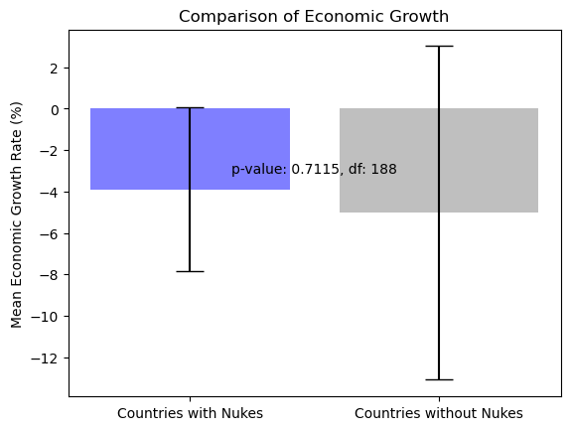
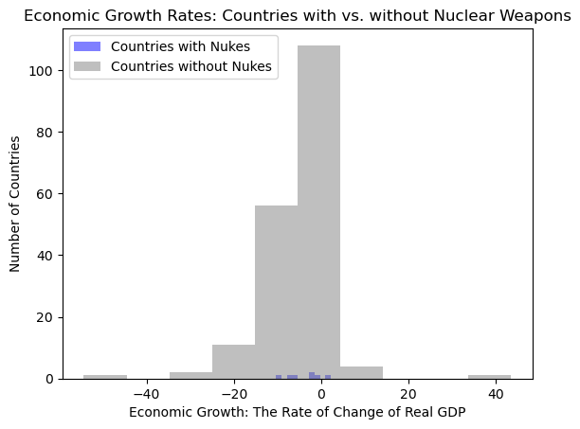
Notes:
This graph compares economic growth rates among countries with and without nuclear weapons. Economic growth varies widely and was influenced by factors like the COVID-19 pandemic. The presence of nuclear weapons does not appear to correlate with higher economic growth.

Slide 11
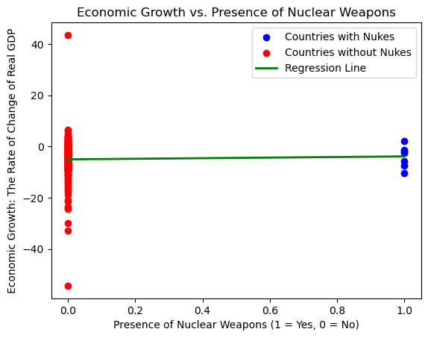
Notes:
This graph examines the relationship between economic growth and the presence of nuclear weapons. Each point represents a country’s economic growth rate and whether it has nuclear weapons. We observe if countries with nuclear weapons tend to have higher or lower economic growth rates. The analysis shows that having nuclear weapons does not necessarily correlate with higher economic growth. This suggests that other factors may play a more significant role in influencing economic growth.

Slide 12
Git Hub Link: https://github.com/Blackbullbjj/eco_v_nukes
Tools Used:
1. Pandas
2. NumPy
3. Matplotlib
4. Scipy
5. Scikit-Learn
6. Plotly
Resources
Global Economy
SIPRI (Stockholm International Peace Research Institute)
Nuclear Threat Initiative.
Data Analysis Completed By: Chanel Jones
chanel.jones.3@us.af.mil
Notes:
This concludes my presentation. Are there any questions?

